Slide 1
EDA – FIFA 2019 World Cup Players
Vinay Nagaraj
DSC530-T301

Slide 2
Contents
Introduction
Statistical or Hypothetical questions
Important Variables
Exploratory Data Analysis

Slide 3
Introduction
FIFA football World Cup is one of the most watched sports event in the world with more than half of the world’s population being its viewers. It is the biggest sporting event on the planet. It is an international association football competition contested by the senior men's national teams of the members of the Fédération Internationale de Football Association (FIFA), the sport's global governing body. This event is played every 4 years.
People around the world are crazy about this event that there would be discussions about who is the best player and each person defending their players, teams. People are awake all night to catch the matches live, then analyze every game, watch highlights, read articles, YouTube videos. It is a religion in some places. The economic crisis of Spain was forgotten, albeit for a few days, when they won the World Cup in 2010. Such is the craze.

Slide 4
Statistical or Hypothetical questions
What is the age of the youngest and oldest player to play the world cup that year?
What is the weight of the lightest and heaviest player to play the world cup that year?
What is the height of the tallest and shortest player to play the world cup that year?
Football Positions of the players
More Left foot or Right foot players
Who are better defenders? Right foot players or Left.
Who are better in Shooting? Right foot players or Left.
What would be an average age of a Player if he has to master the skill of Defending & Shooting?

Slide 5
Important Variables
Age: This column has the age of each player in years
Height: This column has the height of each player in feet
Weight: This column has the weight of each player in pounds
Preferred foot: Player’s preferred foot, Right or Left.
Defending: This is a new column which is mean of Marking, Standing Tackle and Sliding Tackle.
Shooting: This is a new column which is the mean of Finishing, Volleys, Free Kick Accuracy, Shot power, Long shots, Penalties.

Slide 6
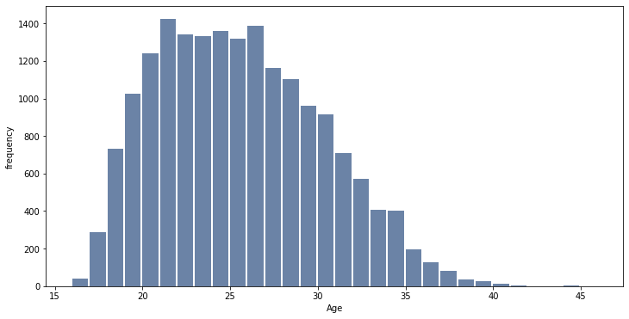
Youngest and Oldest player
Oldest player is 45 years old and Youngest player is 16 years old

Slide 7
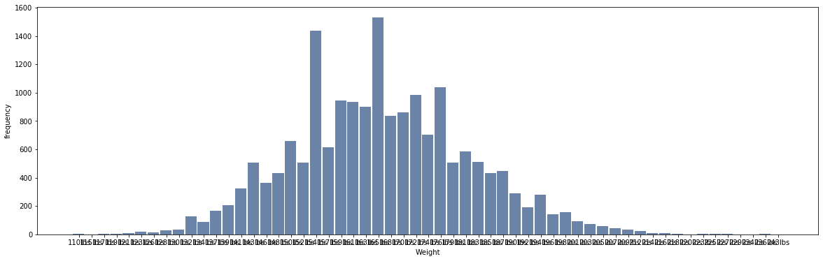
Lightest and Heaviest player
Lightest player is 110lbs and Heaviest player is 243 lbs.

Slide 8
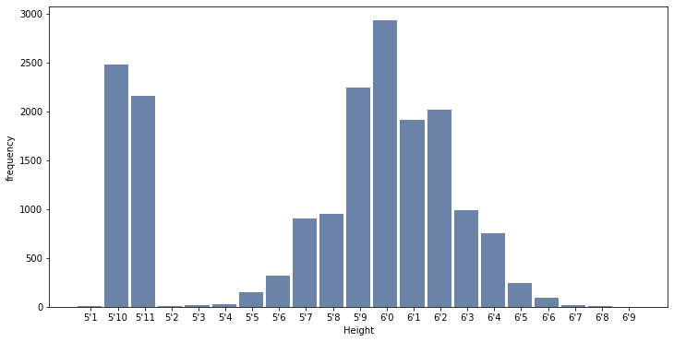
Tallest and Shortest player
Tallest player is 6’9 and shortest player is 5’1.

Slide 9
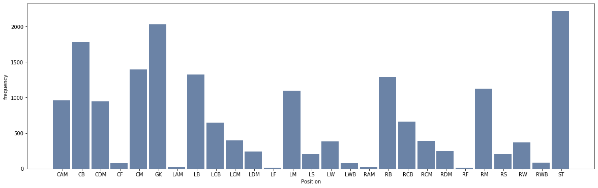
Football Positions
There are 2,212 strikers in out list of players

Slide 10
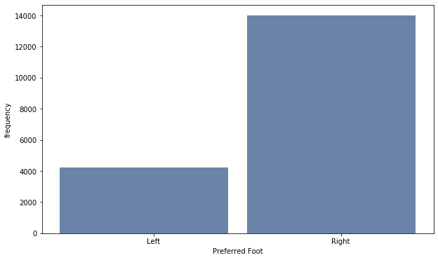
Preferred foot
We have 4,211 Left foot players and 13,995 Right foot players.

Slide 11
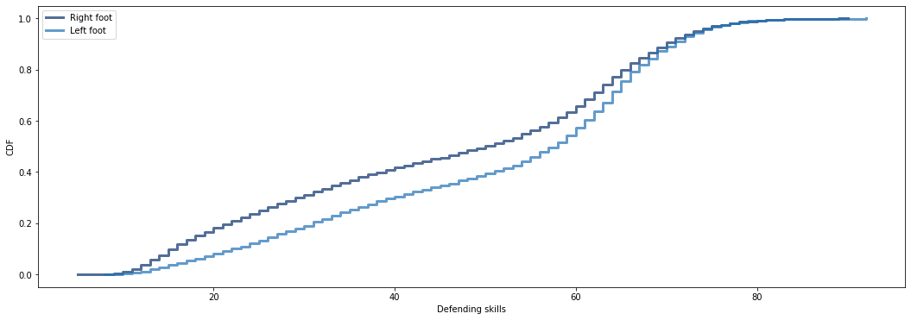
Better Defenders
From the below CDF plot, the shape of the distribution clearly indicates that Left foot players are better in Defending than the Right foot players.

Slide 12
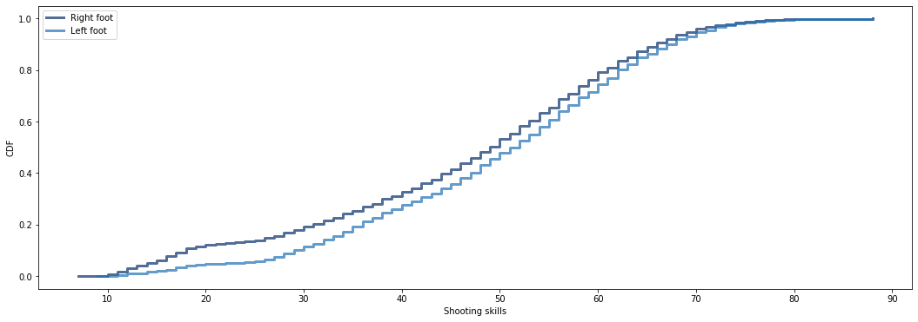
Better Shooters
From the below CDF plot, the shape of the distribution clearly indicates that Left foot players are better in Shooting than the Right foot players.

Slide 13
Thank you!!

